Slide 1
Rahman Ismail Sr. Software Architect
USBIF & WHCK Cert Update

Slide 2
Agenda
Compliance Overview
Compliance Requirements
What is tested?
Introduction to WHCK
Summary

Slide 3
USB 3.0 Certification
What is Compliance?
A series of tests to validate adherence to spec
Testing that duplicates end-user usage to verify that devices work as intended
Interoperability is done with known good devices.
How do I get my Product Certified?
All certification currently done only at PIL lab
DUTs must pass all required tests
Vendor companies can schedule PIL time for debug or certification.
DUTs that are ready for certification can be scheduled for testing and shipped to the PIL

Slide 4
Compliance Program Goals
High Quality Certified SuperSpeed USB Products
Stable, Repeatable, Well Documented Tests
Documented Test Procedures
Documented Test Assertions and Descriptions
Reuse USB 2.0 Compliance Program Infrastructure
Extend and Reuse USBCV
Reuse Existing Compliance Devices
Testing of USB 2.0 capabilities
Extend Compliance Device Infrastructure
Testing of USB 3.0 capabilities
Extend and Reuse Test Services Infrastructure
Minimize Test Equipment Costs
Provide Full End Product Test Coverage at Workshops
Instantly Available Testing (Qualified ITLs)

Slide 5
Compliance Process
Workshops
Test Houses
C&I
Test
Specs
PASS
FAIL
Test Tools
And Procedures
Clear Test Output Maps
Directly to Test Spec
C&I Test Specs
Interpret
Spec Requirements
Define
Test Assertions
Specific Test Requirements
Test Algorithms
Test H/W & S/W
Validates
Test Criteria
Compliance
Interoperability
Predictable Path To Compliance Same Model as USB 2.0 Compliance Program

Slide 6

Passing Compliance = Use Of Logo

Slide 7
Test Spec – Test Assertions
Test assertions provide specific test requirements with spec references
Simple set of ‘yes/no’ questions
Test specs available on the USB-IF website
9.6.1#2 | A device must report a value of 0300H in the bcdUSB field of its Device Descriptor
9.6.1#5 | A device must report a value of 09H in the bMaxPacketSize0 field of its Device Descriptor

Slide 8
Test Spec – Test Descriptions
Test descriptions provide detailed descriptions of how test suites test specific test assertions
EXAMPLE:
Device Descriptor Test
Place device in desired starting state
Send a Control Transfer Request
bRequest set to GetDescriptor
wValue set to the Device Descriptor
wLength set to 12H
Verify Descriptor Type set to DEVICE Descriptor

Slide 9
SuperSpeed C & I Elements
Framework and Interoperability testing
Protocol testing
Link testing
Electrical testing
Cable and Connector testing
Software
Protocol
Link
Physical
Cable and
Connector

Slide 10
Super Speed Device Certification
What is required for Device Certification?
USBCV Chapter 9 Test
USBCV Device Specific Compliance Tests (BOT, UASP, etc)
SuperSpeed USB Electrical Tests
Interoperability and Backwards Compatibility Test
Link Testing
Current Measurement Tests
Testing at supported USB 2.0 speeds (LS/FS/HS)
Chapter 9 Test
Device Specific Compliance Tests
USB 2.0 Electrical and current
Interoperability Test

Slide 11
USB 3.0 Hub Certification
What is required for Hub Certification?
USBCV Chapter 9 Test
USB 3.0 Hub Compliance Test
SuperSpeed USB Electrical Test (Upstream and Downstream)
Interoperability and Backwards Compatibility
Link Testing (Upstream and Downstream)
Current Measurement Tests
Testing at supported 2.0 speeds (FS/HS)
Chapter 9 Test
USB 2.0 Hub Compliance Tests
USB 2.0 Electrical (Upstream and Downstream)
Interoperability

Slide 12
xHCI Host Certification
What is required for Host Certification?
USBCV Chapter 9 Tests using known good devices
All types and speeds of devices and hubs (LS/FS/HS/SS)
USBCV Device Specific tests for all types and speeds of devices
xHCI Host Compliance Tests
SuperSpeed USB Electrical Tests
Interoperability and Backwards Compatibility using Host production driver with U1/U2 enabled
Link Testing
USB 2.0 Electrical Tests
USB 2.0 DUTs submitted for certification will be tested with an xHCI controller as well

Slide 13
Connectors and Cable (Electrical)
Time Domain Measurements
Mated Connector Impedance
Cable Electrical Performance
Characteristic Impedance
Intra-pair Skew
Near-End Crosstalk between SuperSpeed Pairs
Frequency Domain Measurements
Differential Insertion Loss
Differential Near-End Crosstalk Between SuperSpeed Pairs
Differential Crosstalk Between D+/D- and SuperSpeed Pairs
Differential-to-Common-Mode Conversion

Slide 14
Chapter 9 Compliance Tests
What is Tested for Super Speed Devices?
All Descriptors
Suspend/Resume (U1, U2, U3), USB 2 LPM L1 support
Function Suspend
Function Remote Wake
Default, Addressed and Configured device states
Set Configuration
Set Interface
Halt Endpoint
Multiple re-enumerations of device

Slide 15
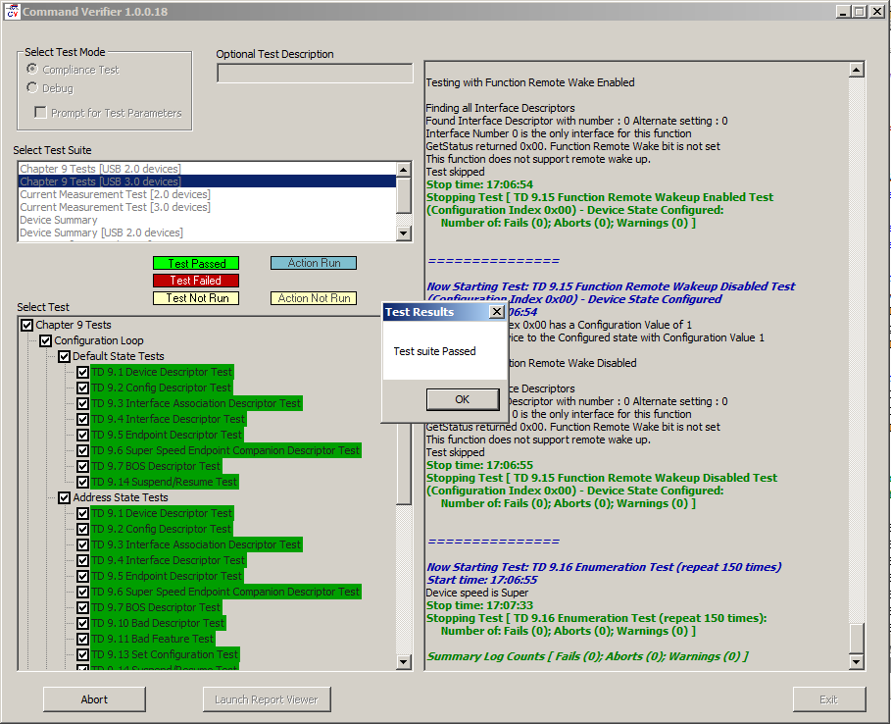
Chapter 9 Compliance Tests

Slide 16
Link Testing
What is tested?
Link and Packet Robustness
CRC
Invalid Commands
Timer Deadlines
LGOOD/LCRD Sequences
U0/U1/U2/U3 Transitions under controlled conditions
Reset initiation and Detection

Slide 17
xHCI Compliance Test Suite
What is Tested?
Registers
Command, Event and Transfer Rings
Port Operation
Required TRBs and Host Commands
Transaction, Babble and Halt errors with compliance device
Port Bandwidth
Control, Interrupt, Bulk & Isoch loopbacks with compliance device
Stall Handling
Periodic Interval Verification

Slide 18
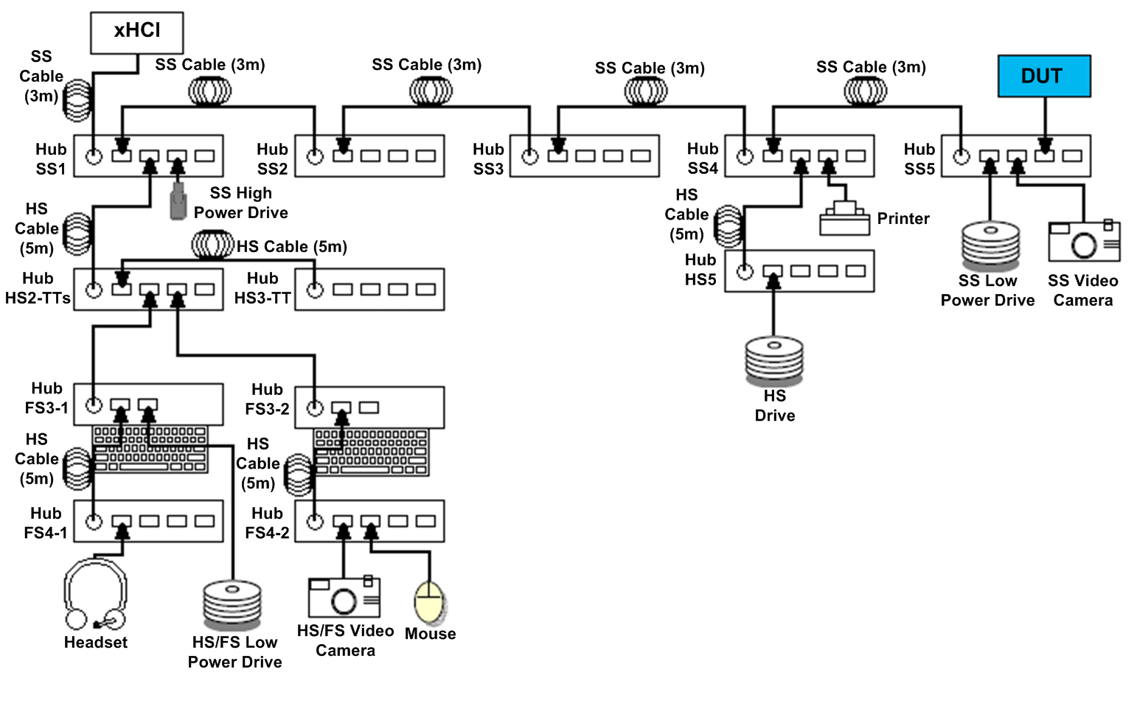
Interoperability and Backwards Compatibility
Topology Change
Devices Enumeration and Operation
Attach/Detach
Warm Boot
Cold Boot
Suspend
Hibernate
Hybrid Sleep

Slide 19
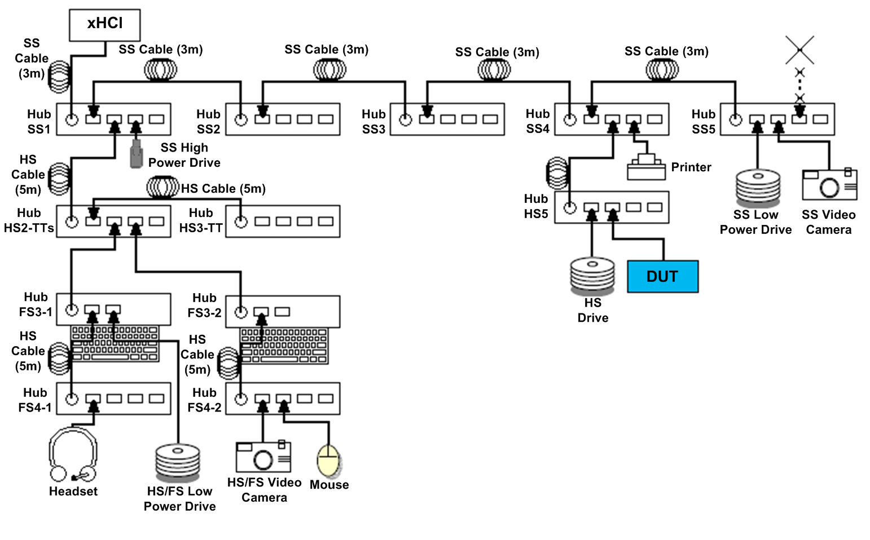
Interoperability and Backwards Compatibility
Topology Change
Devices Enumeration and Operation
Attach/Detach
Warm Boot
Cold Boot
Suspend
Hibernate
Hybrid Sleep

Slide 20
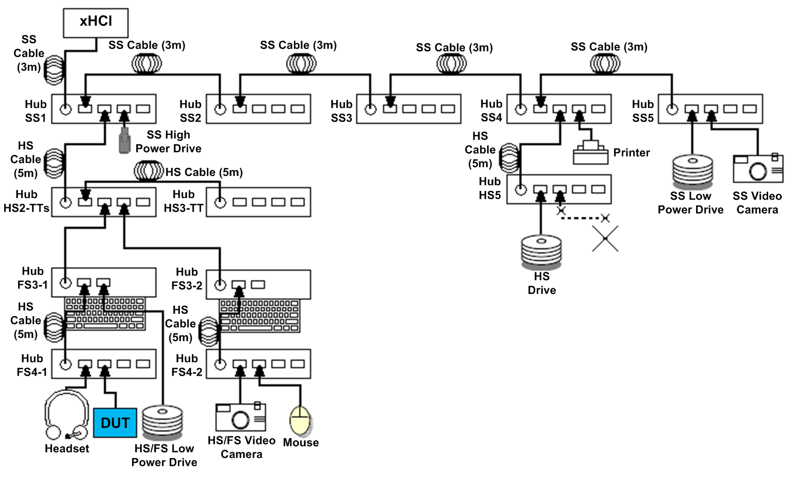
Interoperability and Backwards Compatibility
Topology Change
Devices Enumeration and Operation
Attach/Detach
Warm Boot
Cold Boot
Suspend
Hibernate
Hybrid Sleep

Slide 21
Host Backwards Compatibility
Tested with a sample of 150 popular devices
LS/FS/HS
Composite devices
Printers, cameras, mice, hubs, etc.

Slide 22
Test Coverage
Compliance is not a replacement for validation
Tests attempt to approximate variations that could occur across all hosts
Full coverage not possible with standard host
For example: Test that checks that a device accepts all possible permutations of ACKs with varying NumP and Sequence numbers

Slide 23
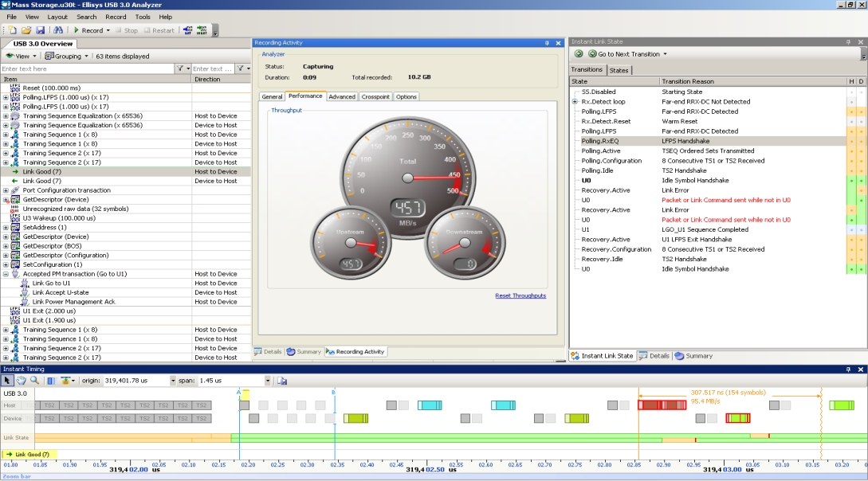
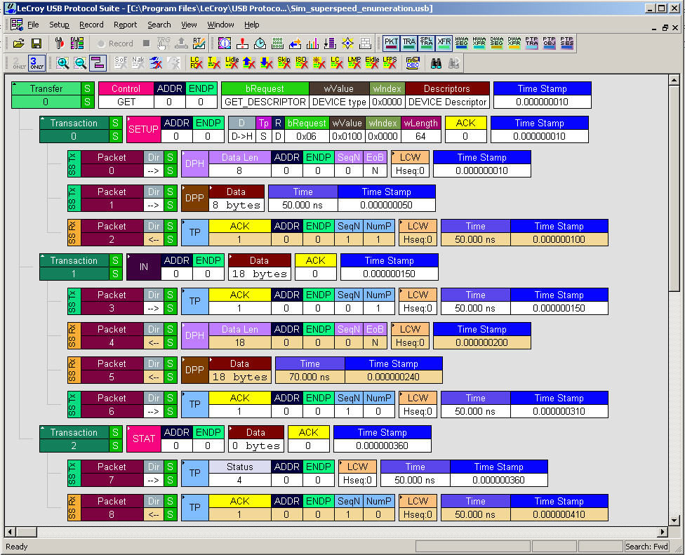
Debugging Tools
SuperSpeed USB protocol analyzers
Ellisys, LeCroy, Total Phase
Physical layer analysis tools
Agilent, LeCroy, Tektronix

Slide 24
Agenda
Compliance Overview
Compliance Requirements
What is tested?
Introduction to WHCK
Summary

Slide 25
What is WHCK?
Windows Hardware Certification Kit
Everything you need to certify your hardware for Windows
Requirements
Tests
Documentation for installing and running tests
Notes:
Good engineering practices to follow regardless of logo certification needs
Tools are there to help for development and quality assurance

Slide 26
WHCK Goals
Ensure the best experience for Windows users
Signed driver are available on Windows Update
Help partners with quality of the hardware and drivers
Motivate adoption of new user experiences and technology across the ecosystem
Notes:
Drivers signed or logoed as part of the device certification can be hosted on WU.
WHCK certification enable drivers to be uploaded on Windows Update
First time install is quick and easy for the users
Maintenance and regular updates are seamless
Provide telemetry information to partners on download numbers, install base, failures, etc.
WU also helps reduce your test burden. If you’re pushing the latest driver out, you can see what % of the install base has moved to that new version, and you can reduce your coverage on older versions.
Additional tests to cover compatibility with Windows features
Success of Windows new features depends on ecosystem adoption and WHCK is one of the driving mechanism to evangelize new Windows capabilities

Slide 27
WHCK USB Logo Programs
Controller Logo
Pass tests that verify USB controller quality
System Logo
All devices and drivers in the system must have device logos or driver quality signatures
Systems must pass additional series of tests
Device Logo
Pass tests that verify device reliability and performance
Hub Logo
In addition to device tests, hubs must pass tests that verify hub reliability and performance
Driver Signature
Meet all criteria for drivers
Notes:
Device Logo program contains bus tests for devices + Device specific functionality testing.
For example a USB storage device must meet USB Device requirements + USB storage requirements
Hub Logo program is a special flavor of USB devices so the program for Hubs covers Device requirements tests + specific hub tests and requirements.
In Windows we support a number of Inbox USB Class Drivers, which would cover most common user device scenarios. In most cases, partners use our inbox solutions. However, if there is a device class that does not have an inbox driver support, there is an option for partners to submit their own driver as part of the WHCK process. When the driver is confirmed to meet all the basic driver requirements, it will get a signature and can then become available on WU for easy distribution or it can be integrated into a system to be submitted for logo certification.

Slide 28


USB-IF Testing for WHCK
Controllers must get full USB-IF certification
Devices must go through USB-IF testing
Full USB-IF certification is optional for devices
Device can either be fully certified by USB-IF
OR
Subset of USB-IF tests (Interop and CV) are passing
Encourage all partners to go through USB-IF certification
Provides electrical, transfer and
Whitepaper on WHDC site
Notes:
As a system vendor you can submit the Test ID of that Controller manufacturer received when getting USB-IF certification given that no major firmware or electrical changes.

Slide 29
Windows USB certification
Run USB-IF Tests
Be aggressive with Power Management
Implement MS Container ID correctly
Consider UASP
Ensure Backwards Compatible
Notes:
For USB 3.0, the Windows Requirements can be summarized into 5 major groups that we touched on during this presentation. Each group containing a set of tests to validate the functionality:
Refer to USB IF
Fully USB IF certified or subset of tests are passing
Support Selective and Function Suspend
Implement MS OS Container ID correctly
Multi-function or multi-transport devices only
UASP support
New protocol for storage devices
Fully backwards compatible

Slide 30
Certification guidance
Use different configurations (hubs, 2.0 and 3.0 cables)
Should just work!
Verify your devices and drivers with Windows 8
Test devices on USB 2.0 and USB 3.0 controllers
Incorporate Windows Certification and USB-IF tests
Notes:
For the sake of time, I am going to summarize our testing guidance into 4 major pillars.
Millions of PCs that are shipping today offer both USB 2 and USB 3 ports, what we call mixed port solutions. There are also millions of legacy PCs that only offer USB 2.0 ports, so there is no guarantee that customers will connect your USB 3.0 devices only to xHCI. You need to ensure that the device works behind EHCI and xHCI. When USB 3.0 device is connected to xHCI the device should works properly at SuperSpeed while on EHCI it falls back to High speed experience. USB 2.0 devices should work at high speed regardless whether they are connected to EHCI or xHCI controllers.
In windows 8, we focused on keeping the API layer for USB 3.0 stack the same as USB 2.0 stack. So ideally no changes are necessary for the drivers. That said, I recommend you still test your drivers. If you find any issues, tell us about it.
Many enthusiasts and developers use hubs to connect their devices (I personally first learned about USB hubs when I joined the USB team two years ago. They make moving/reconnecting devices so much easier). Since the plugs are backwards compatible USB 2.0 cables can be used to connect USB 3.0 devices in which case the device will work at USB 2.0 speeds. Try all the various configurations to ensure they all work correctly. Test add-in controllers as well as onboard, because you’ll see different performance/power characteristics with the different implementations.
Lastly, run all the certification tests even if you have no intention to submit for certification later on. These tools are free and super helpful in targeting key scenarios and cover compatibility with Windows features, which helps prevent future support cost.

Slide 31
Call to action
Utilize USB 3.0 power management and performance features
Test your hardware with Windows 8 build
Run Windows Hardware Certification tests on devices in various configurations
Obtain USB-IF and Windows Hardware Certifications
Notes:
To call out key takeaways from today’s presentation:

Slide 32
Summary
SuperSpeed Compliance Program follows USB 2.0 model
Trademarked Logo For Compliance
High level of testing with initial product rollout
Repeatable tests and procedures
USB-IF provides all required testing at USB-IF workshops
Review test specs and provide feedback
Review Interoperability Procedures

